Slide 1

ECE590-05: Introduction to ML Transfer Learning Project
Nathan Inkawhich
Yifan Li
Hayden Bader
Duke University, Spring 2018

Slide 2
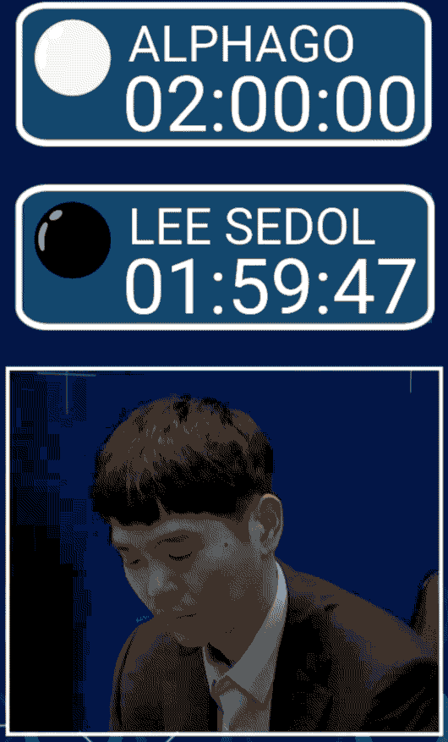
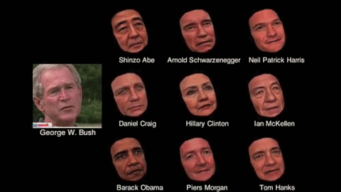

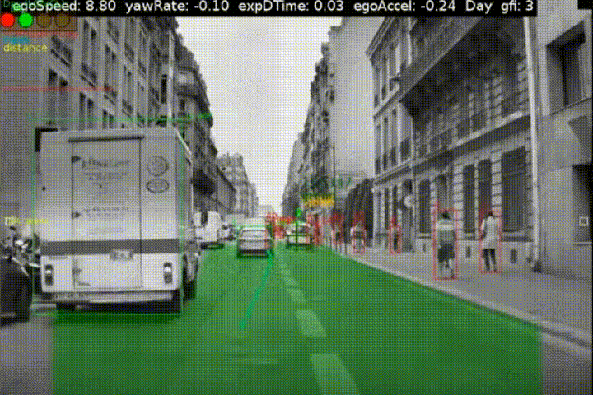
Machine Learning is Everywhere!

Slide 3




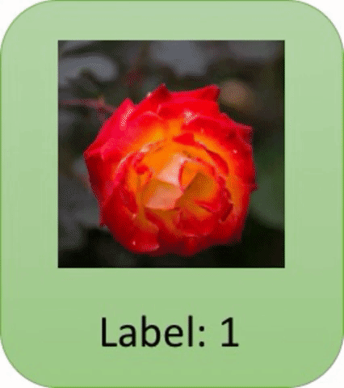


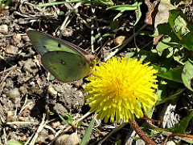








Traditional Supervised Learning Process
Trained Model
Tulip
Lots of Training Images
Lots of Time
Daisy
Dandelion
Sunflower
Rose

Slide 4

Young Programmer Metaphor
C++
I wish I was a C++ expert…

Slide 5


Transfer Learning Process for Programmer
Source Task
Target Task
Guido van Rossum
Learning Algorithm
Knowledge
Transfer Learning = Faster Learning AND Better Performance

Slide 6
Transfer Learning Process for Programmer
Source Task
Target Task
Guido van Rossum
Learning Algorithm
Knowledge
Transfer Learning = Faster Learning AND Better Performance

Slide 7
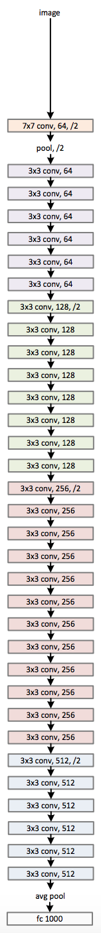

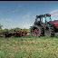

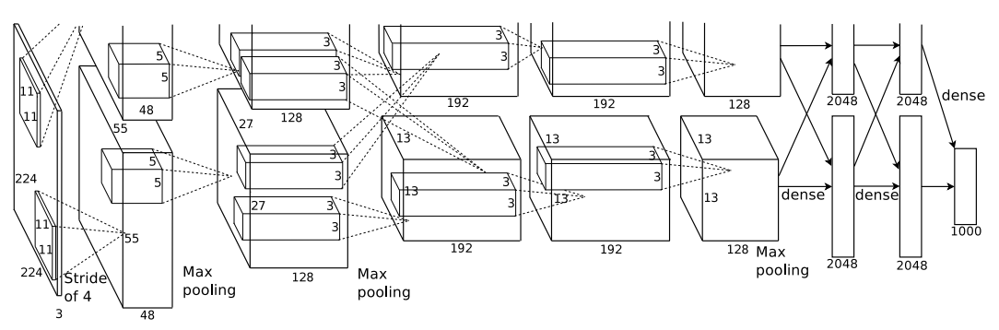
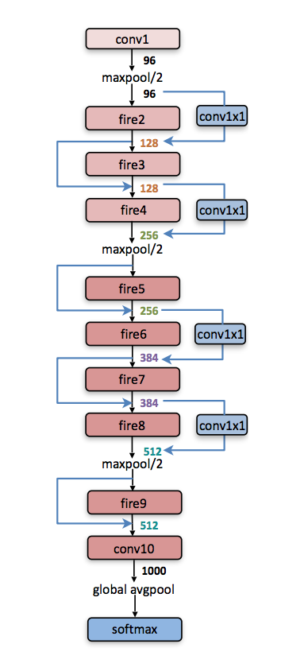
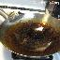

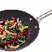






Experimental Setup: Models & Data
Source Data: ImageNet
Target Data: Flowers
Alexnet
Squeezenet
Resnet

Slide 8
Transfer Learning: Finetune vs Feature Extract
Changing
Finetune:
ALL weights updated
Not changing
Changing
Feature Extract:
Only update last layer weights
Note: All weights initialized from pre-trained model.

Slide 9
Transfer Learning: Finetune vs Feature Extract
Changing
Finetune:
ALL weights updated
Not changing
Changing
Feature Extract:
Only update last layer weights
Note: All weights initialized from pre-trained model.

Slide 10
Transfer Learning: Finetune vs Feature Extract
Changing
Finetune:
ALL weights updated
Not changing
Changing
Feature Extract:
Only update last layer weights
Note: All weights initialized from pre-trained model.

Slide 11
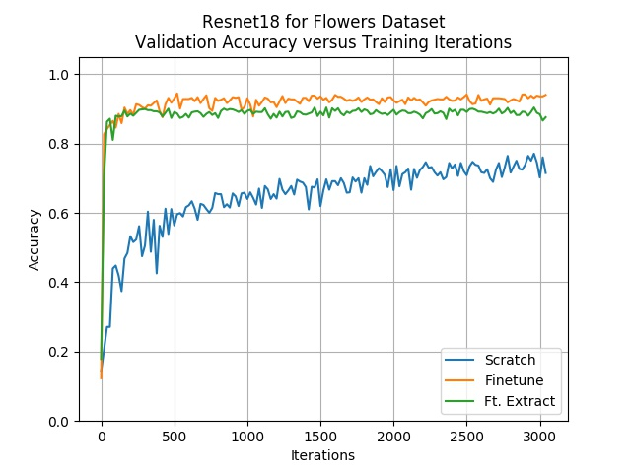
Experimental Results
Finetune
Feature Extract
Scratch

Slide 12
Programmer Destiny
C++

